Slide 1
Inspection Philosophy, Daily diaries and pay quantity diaries
City of Lee’s Summit

Slide 2
Today’s Agenda
Basic Inspection Philosophy
Contractor’s Responsibilities
Owner’s Responsibilities
Role of the “Engineer”
Scenarios
Project Documentation
Daily Diaries
Pay Quantity Diaries

Slide 3
Mike’s Philosophy…
We are not the superintendents on the project.
We don’t share the profit. We don’t share the risk.

Slide 4
Responsibility…
The Contractor’s responsibilities are defined in the contract documents. EJCDC C-700, Article 6 – Contractor’s Responsibilities
As with any responsibilities, these cannot be delegated away. Not to Sub-Contractors and certainly not to the Inspector

Slide 5
Contractor’s Responsibility…
Just what does this article say?
6.01. Contractor shall supervise, inspect and direct the work…
6.01. Contractor shall be solely responsible for methods, means, techniques, sequences and procedures of construction.
6.02. Contractor shall provide competent, suitably qualified personnel to survey and lay out the work and perform construction as required by the contract documents.

Slide 6
Contractor’s Responsibility…
6.03. Contractor shall provide and assume full responsibility for all services, materials, equipment, labor, transportation, construction equipment and machinery, tools, appliances, fuel, power, light, heat, telephone, water, sanitary facilities, temporary facilities, and all other facilities and incidentals necessary for the performance, testing, start‑up, and completion of the Work.
6.06. Contractor shall be solely responsible for scheduling and coordinating the Work of Subcontractors, Suppliers, and other individuals or entities performing or furnishing any of the Work under a direct or indirect contract with Contractor.

Slide 7
Contractor’s Responsibility…
6.06. Contractor shall require all Subcontractors, Suppliers, and such other individuals or entities performing or furnishing any of the Work to communicate with Engineer through Contractor.
6.09. Contractor shall give all notices required by and shall comply with all Laws and Regulations applicable to the performance of the Work.
6.11. During the progress of the Work Contractor shall keep the Site and other areas free from accumulations of waste materials, rubbish, and other debris. Removal and disposal of such waste materials, rubbish, and other debris shall conform to applicable Laws and Regulations.

Slide 8
Contractor’s Responsibility…
6.13. Contractor shall be solely responsible for initiating, maintaining and supervising all safety precautions and programs in connection with the Work.
6.13. Contractor shall inform Owner and Engineer of the specific requirements of Contractor’s safety program with which Owner’s and Engineer’s employees and representatives must comply while at the Site.

Slide 9
Responsibility…
The Owner’s responsibilities are also defined in the contract documents. EJCDC C-700, Article 8 – Owner's Responsibilities

Slide 10
Owner's Responsibility…
Just what does this article say?
8.04. Owner shall make payments to Contractor when they are due as provided in Paragraphs 14.02.C and 14.07.C.
8.07. Owner is obligated to execute Change Orders as indicated in Paragraph 10.03.
8.08. Owner’s responsibility with respect to certain inspections, tests, and approvals is set forth in Paragraph 13.03.B.

Slide 11
Owner's Responsibility…
8.09. The Owner shall not supervise, direct, or have control or authority over, nor be responsible for, Contractor’s means, methods, techniques, sequences, or procedures of construction, or the safety precautions and programs incident thereto, or for any failure of Contractor to comply with Laws and Regulations applicable to the performance of the Work.
8.12. While at the Site, Owner’s employees and representatives shall comply with the specific applicable requirements of Contractor’s safety programs of which Owner has been informed pursuant to Paragraph 6.13.D.

Slide 12
Role of the Engineer During Construction…
The role of the Engineer is defined in the contract documents. EJCDC C-700, Article 9 – Engineer’s Status During Construction.
Who is the Engineer? The term “Engineer” is defined in the project agreement, EJCDC C-520. This should refer to the City of Lee’s Summit Public Works Department.

Slide 13
Engineers Status During Construction (that’s you guys) …
Just what does this article say?
9.02. Engineer will not be required to make exhaustive or continuous inspections on the Site to check the quality or quantity of the Work.
9.04. Engineer may authorize minor variations in the Work from the requirements of the Contract Documents which do not involve an adjustment in the Contract Price or the Contract Times and are compatible with the design concept of the completed Project as a functioning whole as indicated by the Contract Documents.

Slide 14
Engineers Status During Construction (that’s you guys) …
9.05. Engineer will have authority to reject Work which Engineer believes to be defective, or that Engineer believes will not produce a completed Project that conforms to the Contract Documents …
9.07. Engineer will determine the actual quantities and classifications of Unit Price Work performed by Contractor.

Slide 15
Engineers Status During Construction (that’s you guys) …
9.09. Engineer will not supervise, direct, control, or have authority over or be responsible for Contractor’s means, methods, techniques, sequences, or procedures of construction, or the safety precautions and programs incident thereto, or for any failure of Contractor to comply with Laws and Regulations applicable to the performance of the Work.
9.10. While at the Site, Engineer’s employees and representatives shall comply with the specific applicable requirements of Contractor’s safety programs of which Engineer has been informed pursuant to Paragraph 6.13.D.

Slide 16
Final Thoughts…
We are not the Project Superintendents, nor are we to act in that role.
We do not share in the profits, nor should we share in the risks. Anytime you direct the contractor’s schedule, methods or means, you take on the risk.
Watching vs. Inspecting…
Watching is passive. Watching infers acquiescence and may result in sharing contractor’s risk - better to not be present at all than to simply watch and do nothing. Estoppel.
Inspecting is Active. If you whiteness defective work, get involved. Document activities.

Slide 17
Scenario # 1
You are checking the reinforcing steel in the top slab of a box-culvert and discover that the location and spacing of the steel is wrong. The first load of concrete is currently being tested. What do you do?

Slide 18
Scenario # 1
It is the contractor’s responsibility to get the work right. Just-in-time inspection is okay.

Slide 19
Scenario # 2
One day after an ADA curb ramp was poured in December, high winds overnight have blow off the insulating blankets protecting the ramp. A thermometer records the surface temperature of the concrete at 38 degrees. You find the situation at 10 A.M. the next day. The contractor is not on the project. It is 18 degrees now. The forecast high is 25 degrees. What do you do?

Slide 20
Scenario # 2
As an inspector, it is your responsibility to notify the contractor if you become aware of a problem. It is the contractor’s responsibility to decide how to react to that problem.

Slide 21
Scenario # 3
You are the inspector over a concrete pavement pour. With just four loads of concrete left in the pour, an unexpected rain hits the project. The paving superintendent asks you if it is okay to place the last four loads of concrete. He informs you he has enough plastic to cover the pavement. How do you respond?

Slide 22
Scenario # 3
The contractor is responsible for completed work

Slide 23
Scenario # 4
A ready-mixed concrete truck driver is cleaning out his drum in a place that drains directly into a stream. When you confront him about it he becomes belligerent. What do you do?

Slide 24
Scenario # 4
As an inspector you have the authority to insist upon contract compliance. It is the contractor’s responsibility to deal with suppliers.

Slide 25
Scenario # 5
A by-pass is being torn up under traffic. You tell the contractor to make repairs. The contractor refuses, saying the by-pass is under-designed. What do you do?

Slide 26
Scenario # 5
It may be that the bypass is under-designed. But, the present issue is that it must be maintained. Design can be investigated later. In the meantime, keep records to help resolve any potential claim.

Slide 27
Scenario # 6
You are the inspector for a curb replacement project. You check the weeks forecast and it says 70% chance of heavy rain for the next five days. You drive out to the site and observe the tear out crew removing curb. What do you do.

Slide 28
Scenario # 6
Remember, the Contractor is solely responsible for methods, means, techniques, sequences and procedures of construction. If we take on this role, we are accepting some risk.

Slide 29
Engineer/Contractor Relations
These scenarios are examples of crisis-management. Strive to head off problems before they reach that stage.
Remember, we are not here to break contractor’s. We are here to ensure compliance with the contract documents. It’s okay if the contractor makes a profit. In fact, it’s a good thing.
Always relate to the contractor as part of the solution, not part of the problem
But if there are issues, DOCUMENT…

Slide 30
Non-uniform enforcement can cause problems
If an inspector yields on a specification requirement without good reason, a new “bench mark” is set and the contractor and other contractors feel entitled to that yielding from that point on.
Many of us work with the same contractor’s. We must always speak with a unified voice.
There are times exceptions must be made. We must be able to defend our actions to other contractors. Including the second low bidder.

Slide 31
Break Time

Slide 32
Daily Diaries & Pay Quantity Diaries
How to maintain a Daily Diary and Pay Quantity Diaries for CIP projects
This applies to all CIP projects regardless of funding. Federal, State or 100% Local Funds
Aside from Labor documentation, Development Inspectors should record the same information in their Daily Diaries. This information may become critical for supporting future warranty claims.

Slide 33
Why are Diaries Necessary and Important
Documentation of the contractor and his activities is required for ALL Capital Improvement Projects. Why…
Official record of daily events on project
Accurate record of required repairs or modifications
Assures QC/QA is taking place
Accurate record of work completed
Source documentation for payments to contractor
Clearly Communicates Inspectors Actions
Accurate records keep us out of court
Notes:
Official record of daily events on project.
With out records and documentation no one will remember exactly what happened
Accurate record of required repairs or modifications
Documents the changes and why
Assures Quality control, Good Workmanship & Materials
Without good documentation there is no assurance that the project was constructed to specifications outlined in the contract.
Accurate Pay Quantities
Source documentation for payments to contractor
Without accurate to date quantity documentation, a request for reimbursement can not be made
Clearly Communicates Inspectors Actions
Easier to answer questions as to why you did things the way you did and why decisions were made.
Accurate records eliminate wasteful spending

Slide 34
Good Diary Etiquette
Five C’s of Good Report Writing:
• Clear – Being clear refers to both handwriting and meaning. Being clear in meaning is essential. What ever is written has to be clear even to people not involved with the project.
• Concise – Being concise means using the minimum number of words to get the maximum amount of meaning. The rule is, write enough to be clear, but not any more than is necessary. Record the facts and keep opinions out of your diary.
• Correct – Being correct means having your facts straight and using the right forms. Using the wrong form, or making errors, gives the appearance of sloppiness and can cause big problems in arbitrations or litigation proceedings.
Notes:
Clear – A diary must be able to be read. If not it is no good.
Concise - The rule is, write enough to be clear, but not any more than is necessary.
Correct – Re-read and double check what is documented.

Slide 35
Good Diary Etiquette
Five C’s of Good Report Writing:
• Complete – Being complete means including everything necessary to be clear. To be complete, the entry should contain four criteria: Activity–Testing–Results-Action Taken, as well as referencing other types of available project documentation.
• Concurrent – Contract documentation should be completed concurrent with the construction activity. Extensive facts, figures and conversations are hard to remember, write them down as soon as possible, taking abbreviated notes.
Notes:
Complete – When documenting Daily events make sure you include everything so someone else will be able to readily follow the days events if read.
Concurrent – Do your diaries everyday. More than once a day if needed. Nobody likes to do it

Slide 36
Facts Only !! No Opinions
The diary records the inspector’s project specific observations and measurements, which provides valuable project information.
Be professional – No Personal comments
Instill Credibility into Project records
The documentation also provides historical information on how the work was constructed.
Daily information recorded, not week to week or month to month
Evidence in Claim Resolution

Slide 37
Diary Tips…
Carry a small note pad in your pocket at all times. As things happen, jot down a short note. This will keep you from forgetting what happened during the day.
Update the Daily Diary DAILY! Pick a time at the end of the day and try to stick to a routine. If the end of the day wont work, update the Diary throughout the day.
Do NOT put it off! While you may, on occasion, have to put it off until the next day, this should be the exception and not the rule.
This is not an option. It is a requirement for any project receiving Federal Funds. An inadequate Diary is cause for the FHWA to withhold funds.

Slide 38
Diary Tips…
While Photographs can provide additional information to support the written diaries, photographs are not an accepted alternative to written Diaries.
We currently have no means for an electronic diary. Keeping notes in a Word document on a laptop is not an acceptable form. More on this later.

Slide 39
Two Types of Project Diaries (required for every project)
Daily Dairy – (Inspector’s Diary)
Includes entries such as:
Date & Weather
Document every rain event
Instructions/conversation w/ Contractor, property owners, project managers, etc.
Office or Field Visitors
Equipment & Manpower Present
Wage Information. DBE & CUF if required
Material Delivery & Certifications
Material Rejection w/ explanation
Testing & Results
Pay Quantity Diary
All contract bid items must be listed
All bid items shall include:
Item Description
Plan Quantity
Price
Quantity Placed (Today & To Date)
Location (Station, Lt. or Rt.)
Inspector’s Signature/Initial
Remarks
Sketches or Drawings if Needed
The inspector shall verify all pay items incorporated into the project
Notes:
Hand out the 25 do’s and Do not’s.
If something is to be paid for, it must be inspected.

Slide 40
Daily Diary
The Daily/Inspector’s diary should represent a summary of the days construction activities.
In addition to recording inspection observations and measurements, inspectors should summarize delays, breakdowns, idle time, changes in production rates, work accomplished and other important events that effect or objectively explain the contractor’s progress.
It is very important for the inspector to record when a subcontractor begins work on the project and when that subcontractor’s work was complete. These entries shall correspond to payroll records and DBE/CUF reports when required.
Notes:
This is important to track the percentages of work for the prime contractor (30%) and percentages of DBE’s.

Slide 41
Daily Diary
Material Delivery should be noted in the diary as well as the accompanying certifications for the material and their coatings. Note if incidental materials were used and if they were from an approved source. ( Epoxy paint, Curing Compound, Linseed Oil, etc.)
Testing and results should be documented every time a test is performed. If test results are not documented, they never occurred.
When required by the contract, document what DBE’s were present on the project and what commercially useful function (CUF) were they performing. What was accomplished for the day. Were CUF interviews performed at least once per DBE vendor?
Notes:
Document “Buy America”

Slide 42
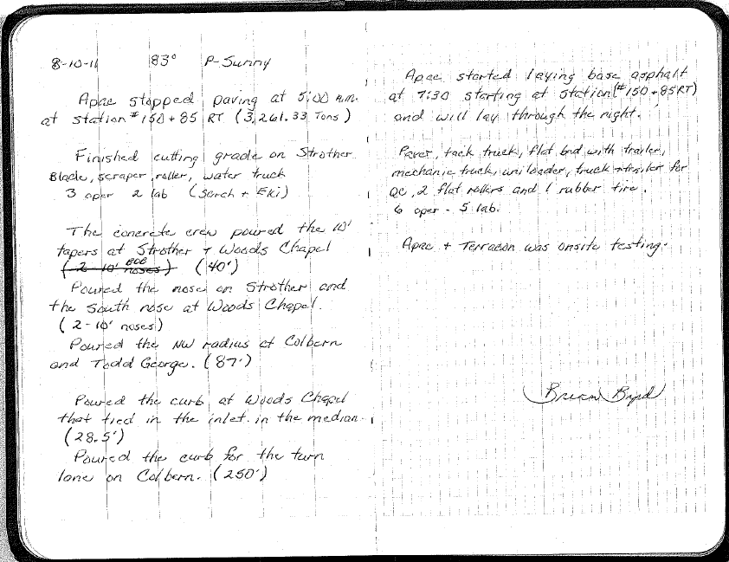
Daily Diary Examples

Slide 43
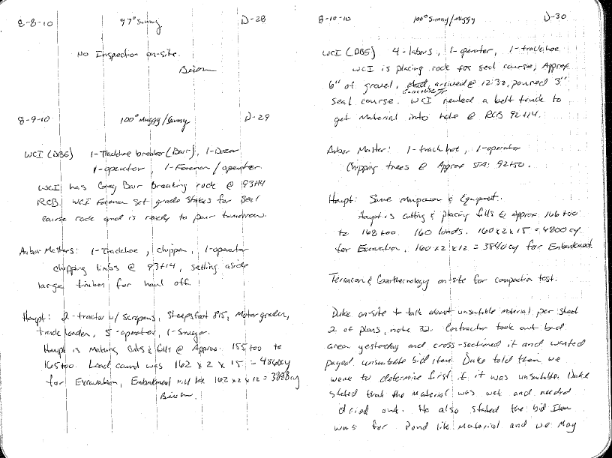
Daily Diary Examples

Slide 44
Pay Item Diary
Pay item information should include location, quantity, correct unit of measurement, line item number, item description, and remarks.
Pay quantities are required to be measured and documented for contract payment and tracking purposes. They should be measured and entered daily.
List if item was supplied or installed by DBE and how much man power and time it took.
Good documentation of pay quantities is needed to avoid underpaying, overpaying, or double-paying the contractor for completed work.

Slide 45
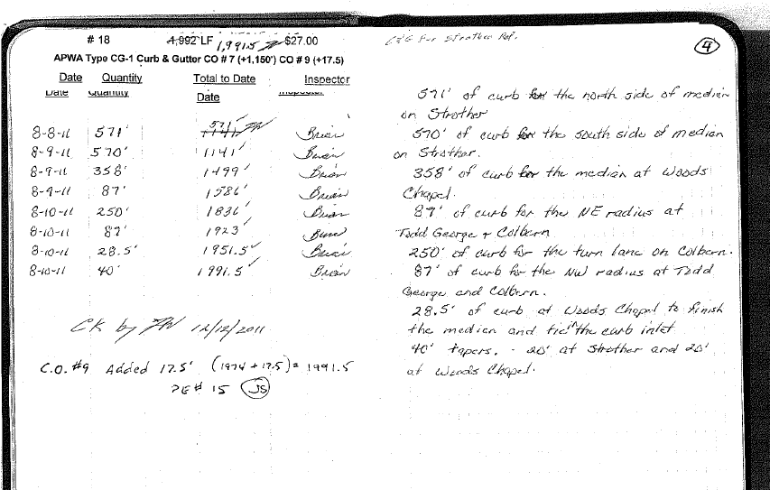
Pay Item Diary Examples

Slide 46
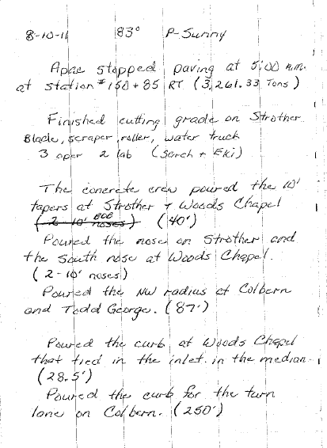
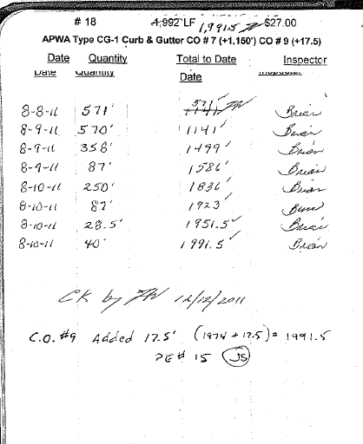
Pay Item Diary Examples

Slide 47
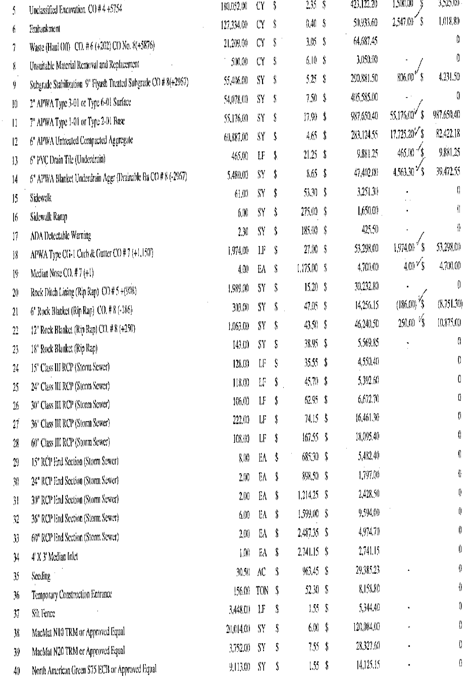
Pay Item Diary Examples

Slide 48
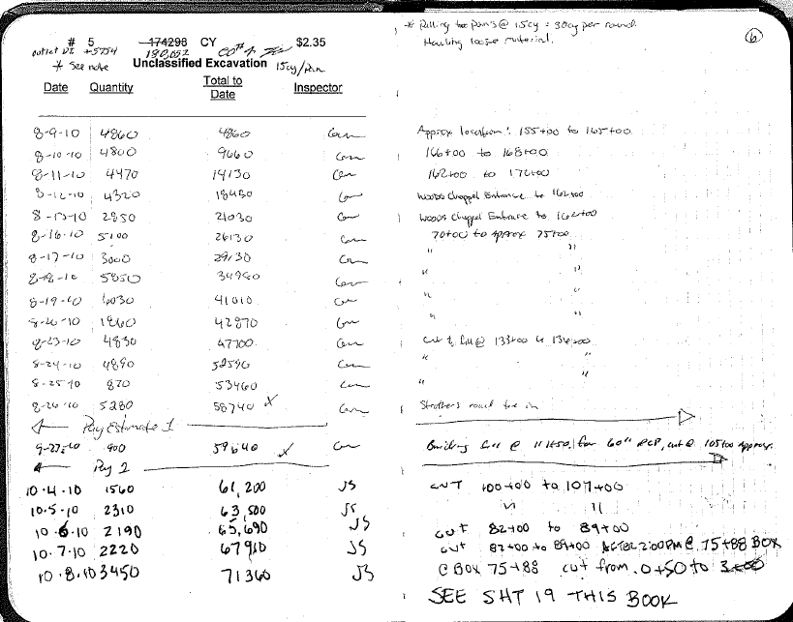
Pay Item Diary Examples

Slide 49
Pay Item Diary (Set-Up) Examples

Slide 50
Summary
All Diary entries should be able to answer the following:
Who
What
Where
When
Notes:
Who was involved.
What happened.
Where it happened at.
When it happened

Slide 51
Summary
Be neat and legible
Record data in a clear and consistent manner
Bound field book is best.
Computer Dairies are allowed if securely backed up. Dairies can not be changed once saved.
Part of project’s permanent record
Never erase or white-out, if you must revise your documentation, line through bad documentation, date and initial
If in doubt…write it down!

Slide 52
Additional References
For more information, see MoDOT’s LPA Construction Guidance in EPG 136.11.

Slide 53
Questions

